Slide 1
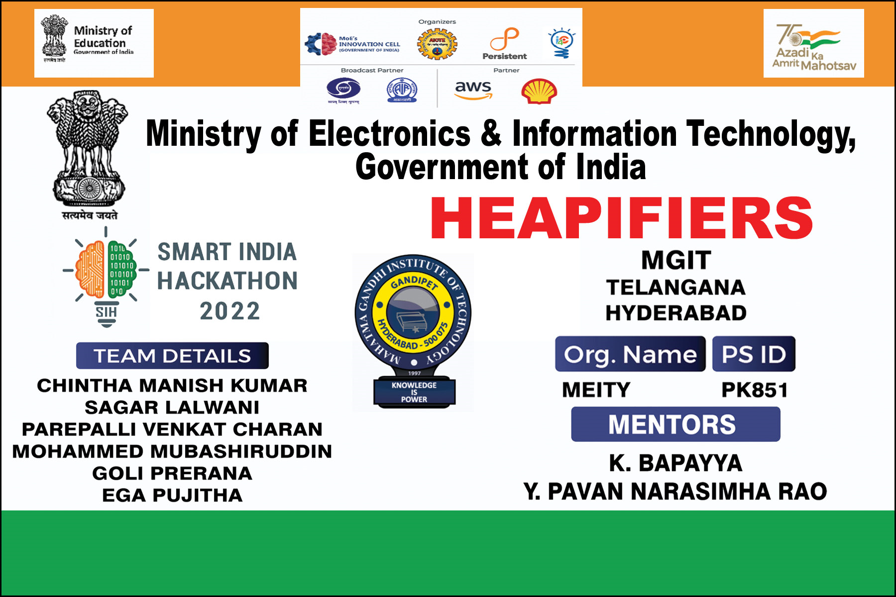
HEAPIFIERS
Venue:
Talla Padmavathi College of Engineering, Kazipet, Telangana

Slide 2
Ministry of Electronics and Information Technology (MEITY).
PROBLEM STATEMENT:
Offline Portal For Direct Benefit Transfer of Scholarship
Direct Benefit Transfers (DBTs) have turned into the standard Government plans utilizing
DBT to move money to needy recipients.
In a Mobile Vaani overview, 1 of every 5 respondents said they don't have banks in their
area, and as the discoveries partook in this LibTech study,
We frequently hear on Mobile Vaani that individuals venture out a few kilometers to get to
their NREGA compensation and other government qualifications.
The Department of Education conducts various scholarship programs and drives to
felicitate learning through monetary incentives among rural areas.
The money is sent physically via cheques and drafts, but the process is not reliable and
time-consuming.
This project aims to minimize/remove the hesitance and issues with DBTs. It tends to
explore the flow and technologies needed to improve the processes of digital scholarship
payment."

Slide 3
Design of Power Line Carrier Communication System
AC
AC
Carrier Module
Master Computer-1
Govt. of India/ Authorities
Govt. of India/ Authorities
Volunteer/
Beneficiary

Slide 4
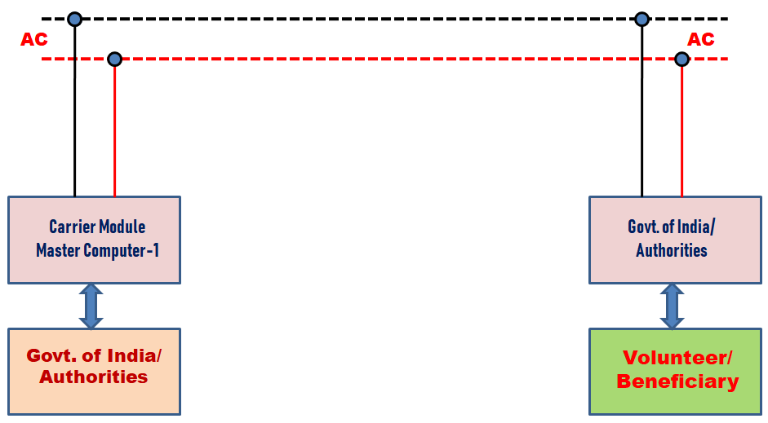
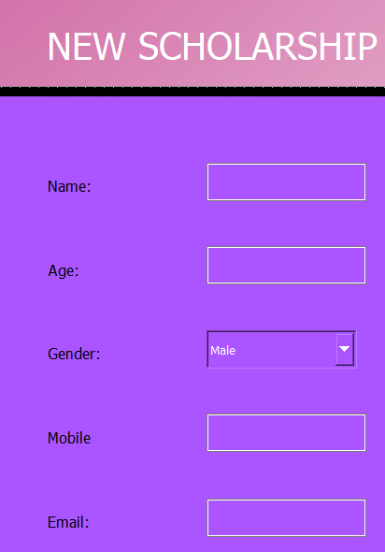
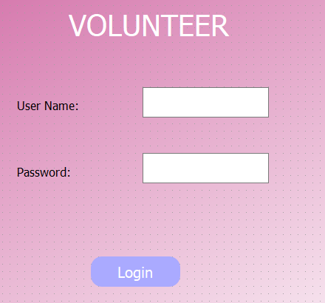
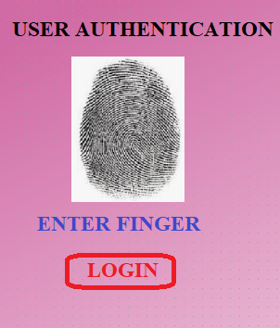
Integration of GUI with PLCC
.
Operated by Govt./ Officer
Operated by Volunteer
Beneficiary

Slide 5
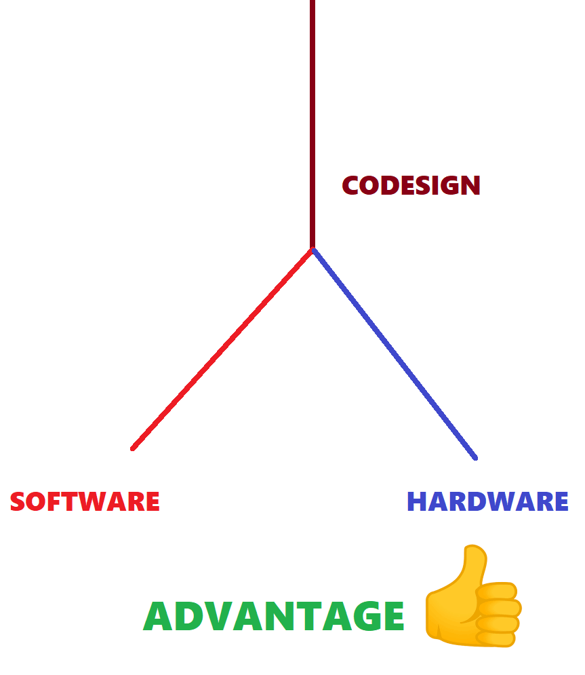
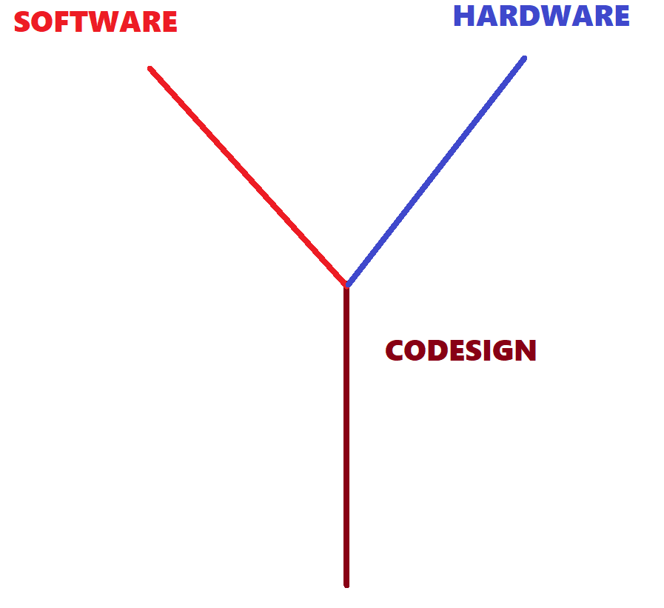
Hardware/software co-design means meeting system level objectives by exploiting the synergism of hardware and software through their concurrent design
HSCD

Slide 6
Modules Used
Software Used
1. Python 3.9
2. PyQt5
3. Pyrebase
4. Firebase
5. Json
Hardware Used
1. Raspberry Pi
2. Arduino Uno/ Nano
3. Fingerprint Scanner
4. PLCC-KQ

Slide 7
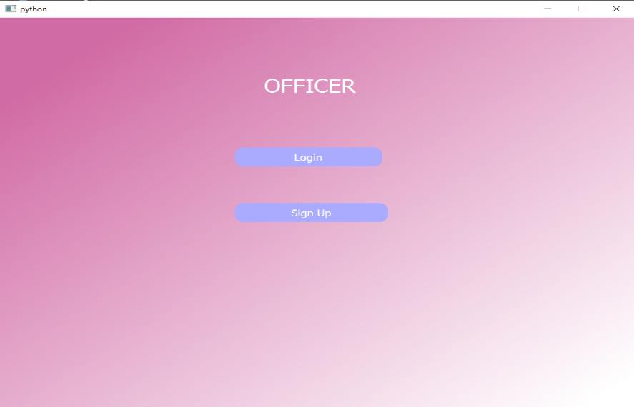
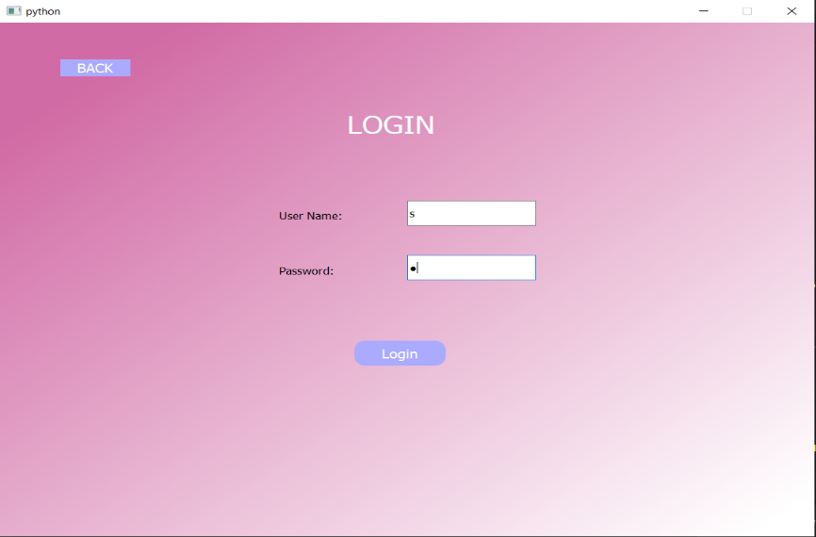
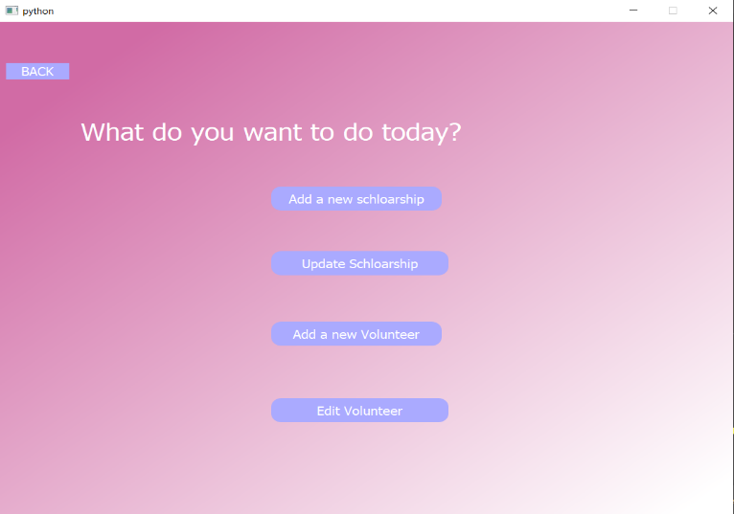
GUI FOR GOVT./OFFICER
Fig.: Graphical User Interface for Govt. (or) Officer

Slide 8
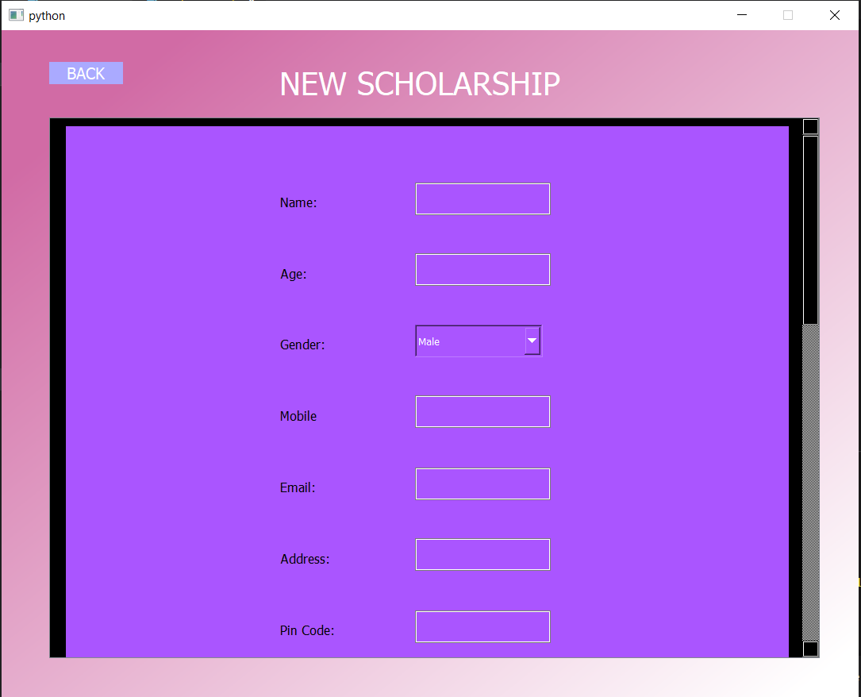
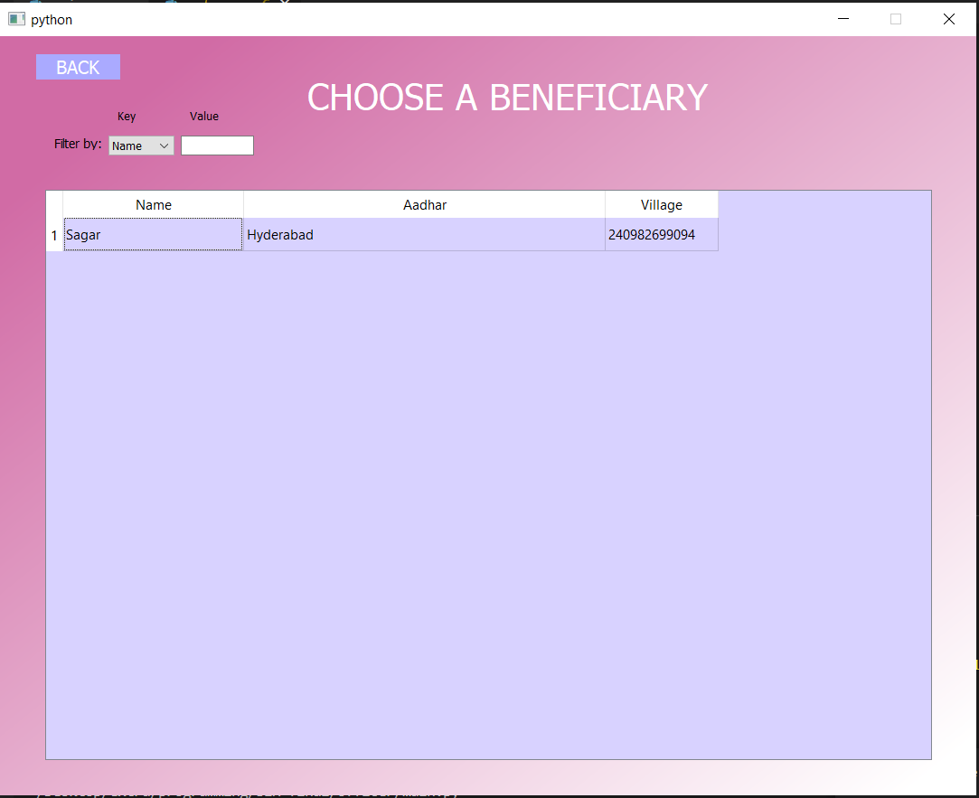
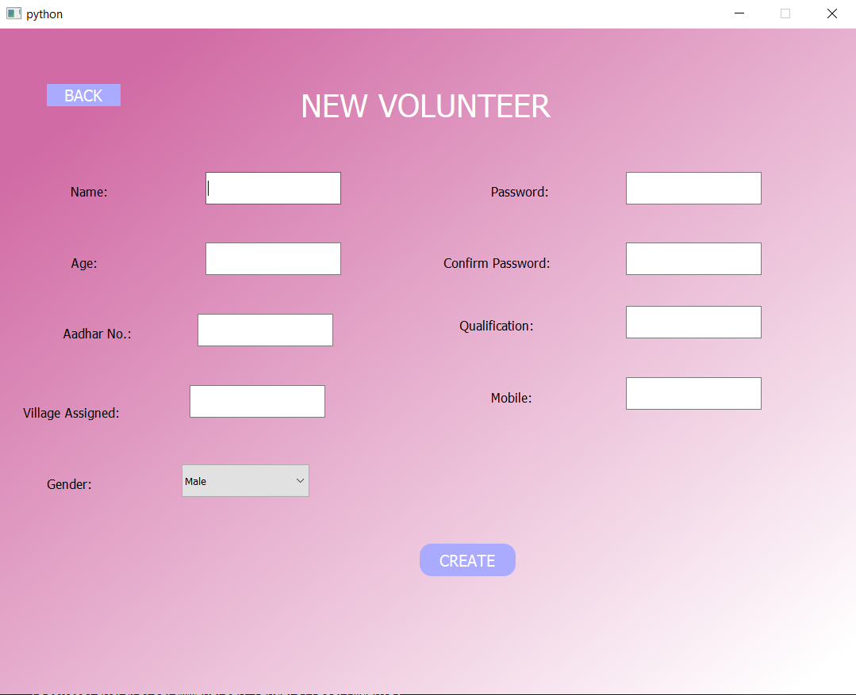
.
(Continued…)
Fig.: GUI for Govt./Officer

Slide 9
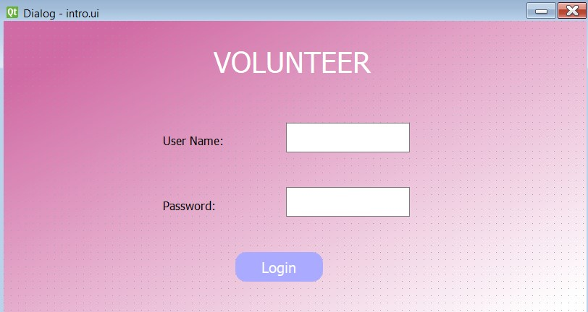
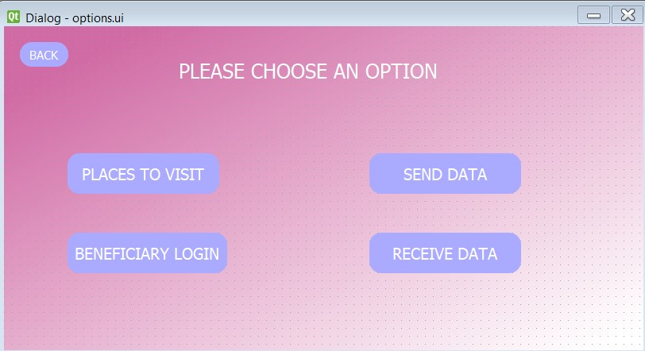
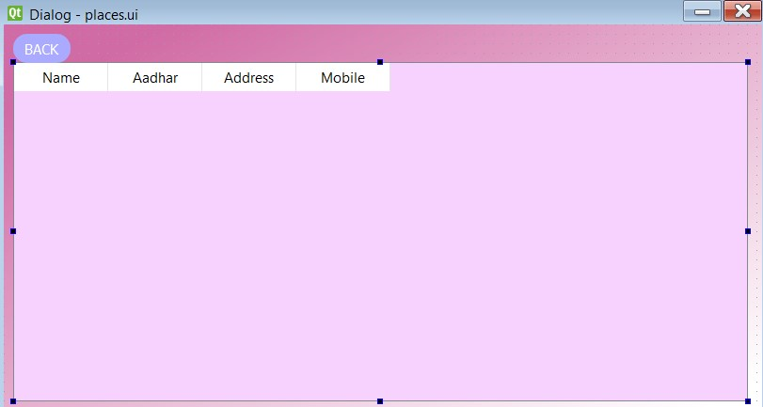
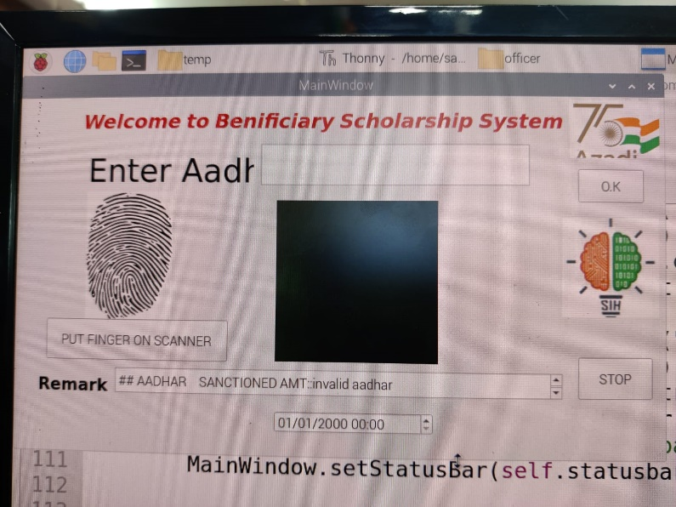
GUI FOR VOLUNTEER
Fig.: GUI for Volunteer

Slide 10
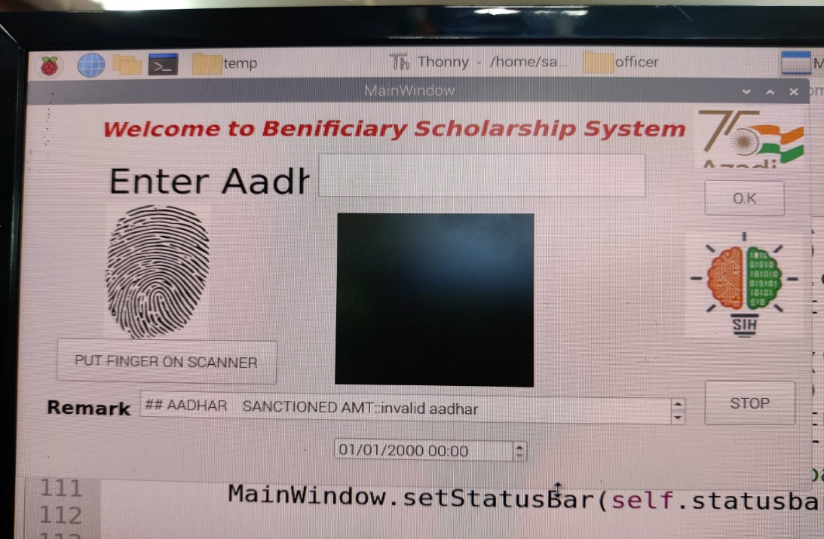
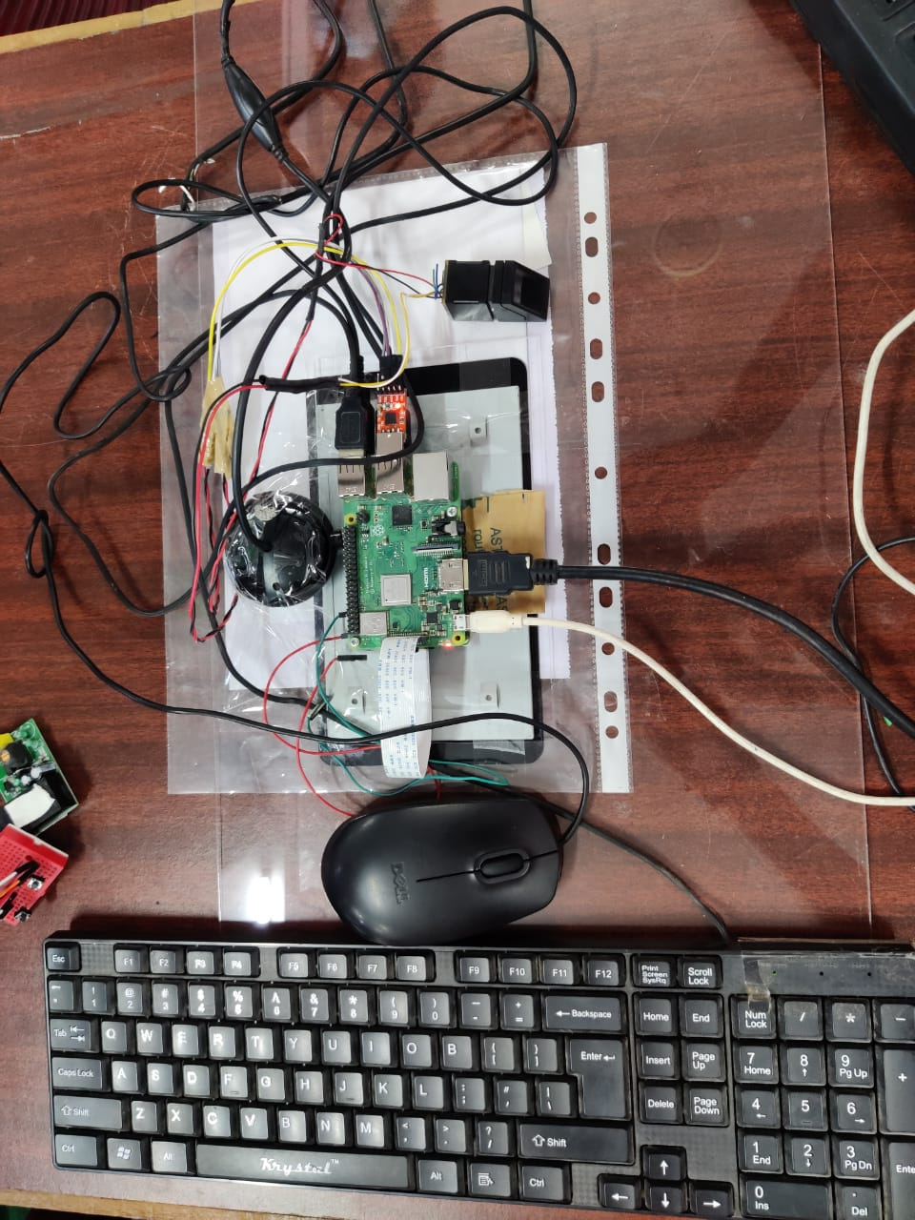
VOLUNTEER MODULE
Fig :Volunteer Module using Raspberry Pi
Fig.: Implementation on Raspberry Pi
(Rear view)

Slide 11
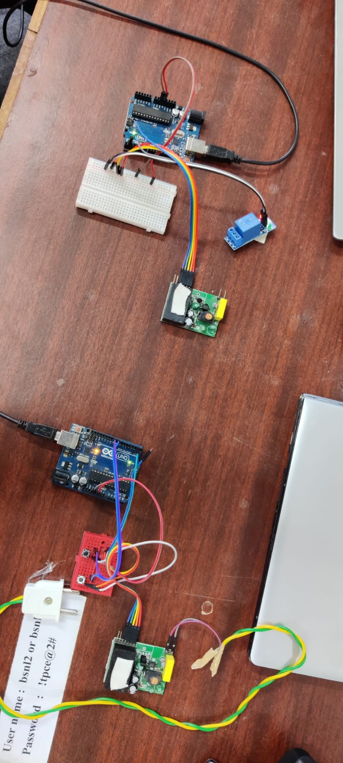
Power Line Carrier Communication System (PLCC)
Fig: PLCC Implementation Using Microcontroller(ardiuno)

Slide 12
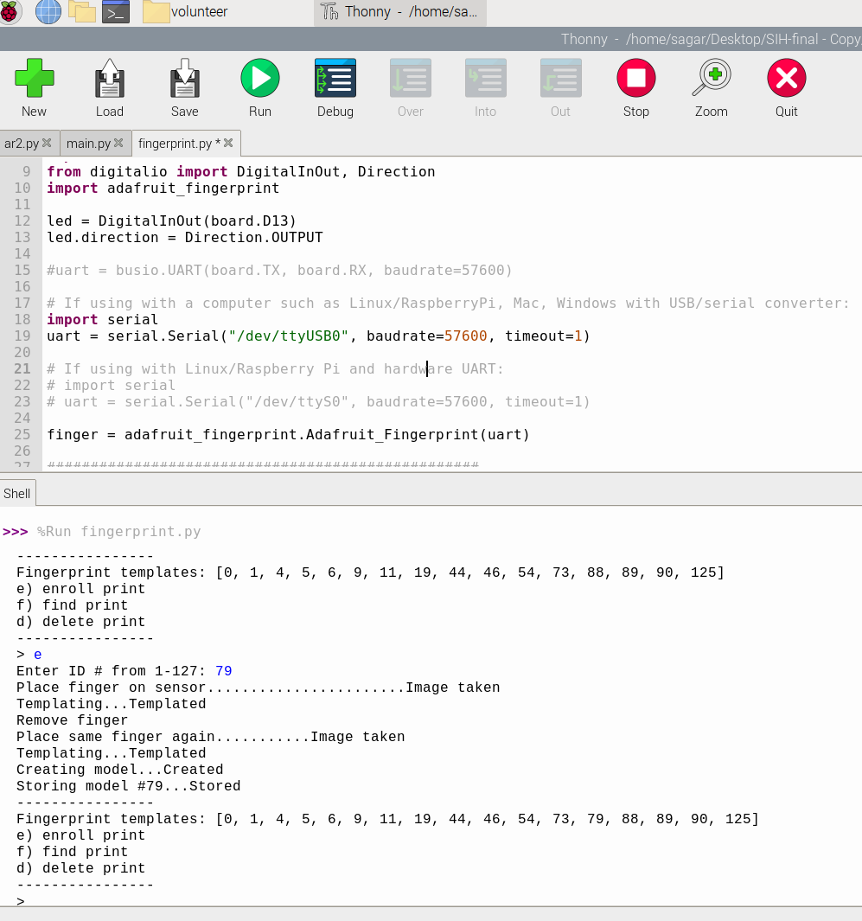
.
Fig.: Shows enrolment , search and deletion of print

Slide 13
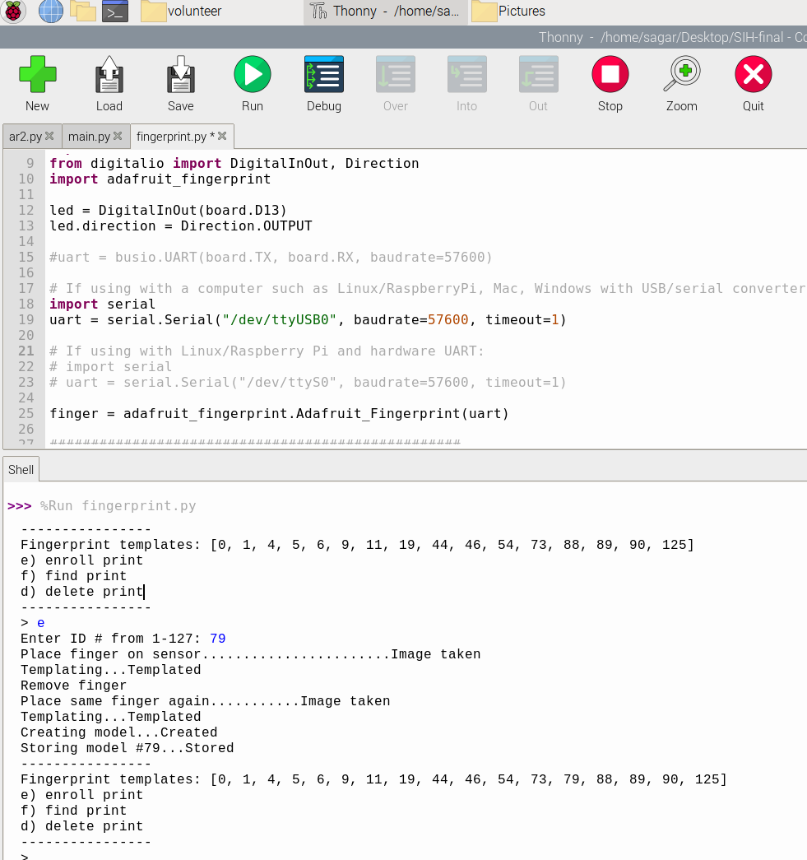

Slide 14
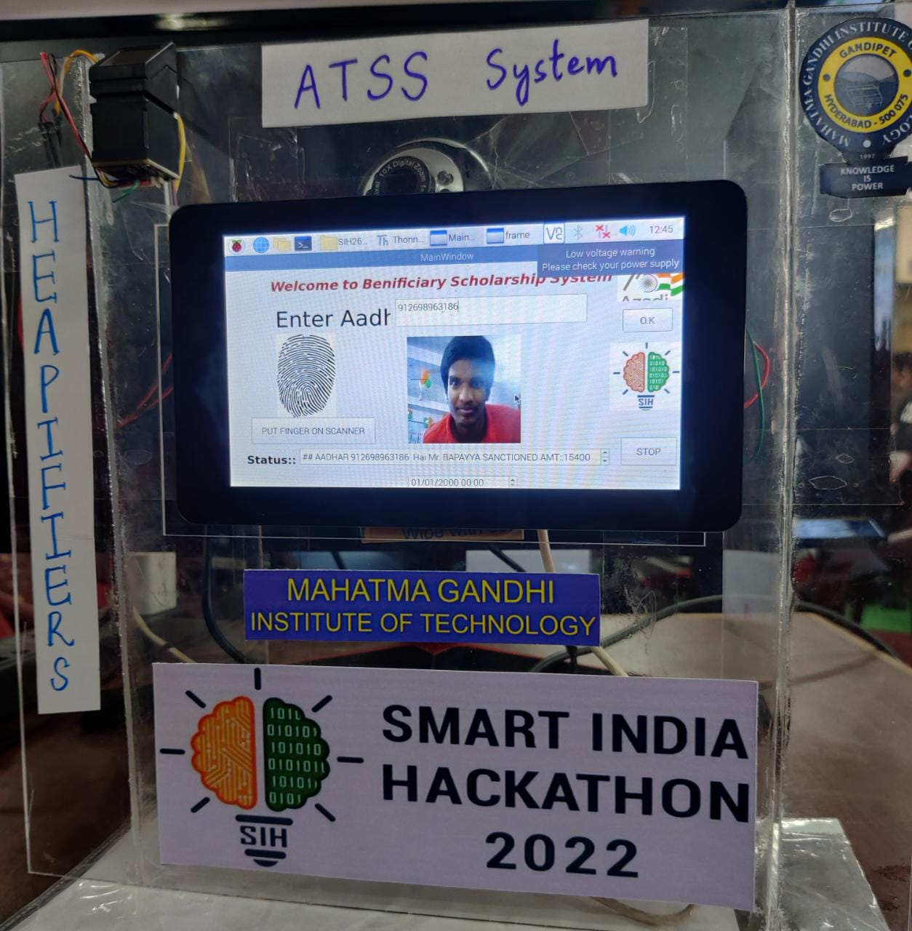
.
.
Fig.: Any Time Scholarship Status System

Slide 15
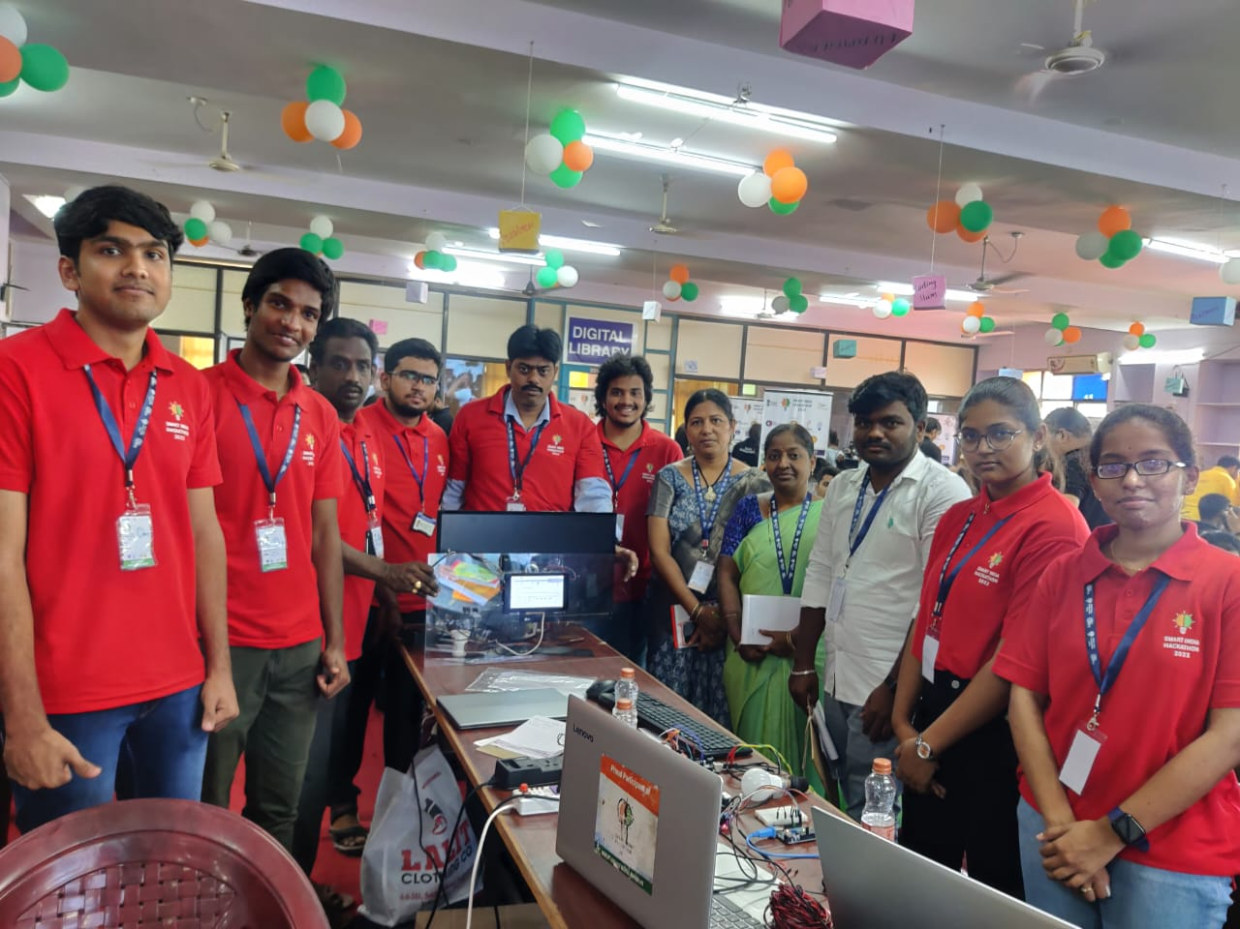
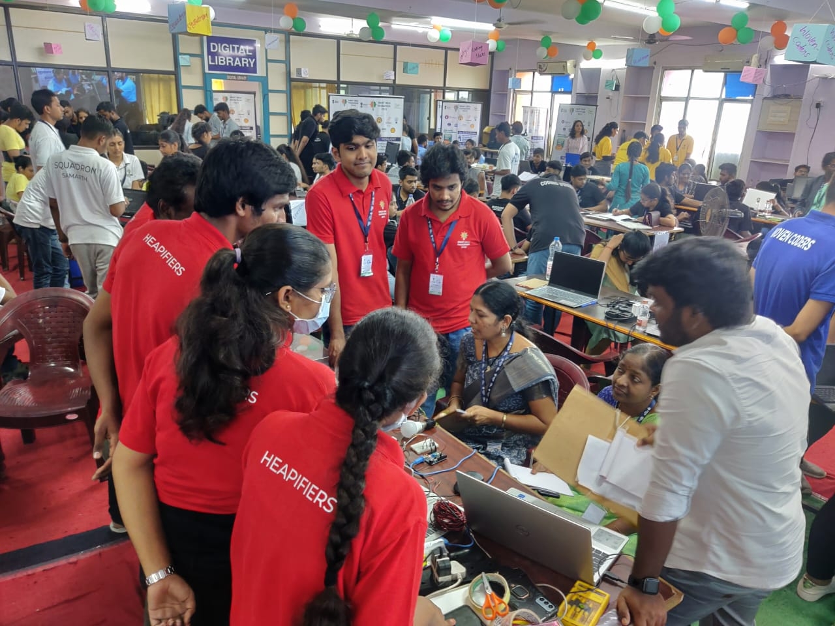

Slide 16
THANK YOU

